Slide 1
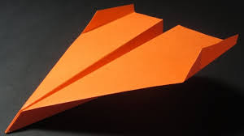
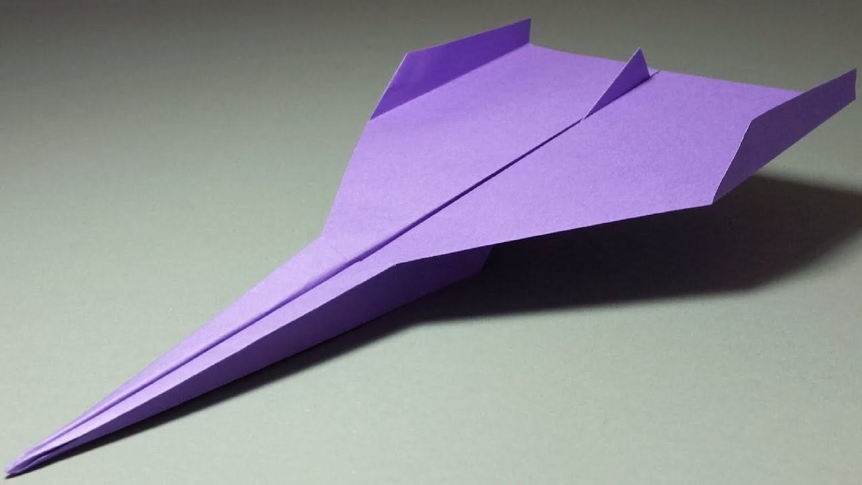
Paper Airplane Flight
By Genevieve Stinson

Slide 2
Goals and Objectives
Goal: The students will use their knowledge of standard deviation to compare and interpret a spread of data sets.
Objective: Given colored sheets of paper students will make three different types of paper airplanes. Then students will measure the distance each airplane goes in at least 5 trials, record the data, and interpret the results by calculating the standard deviation to determine which plane build is most consistent.

Slide 3
Materials
Sheets of colored paper
Measuring tape
Masking tape
Calculator

Slide 4
Steps
Build 3 different paper airplane models and label them A, B, and C.
Pick a launch point on the floor and put a piece of masking tape on it labeled “launch.”
Stand on the launch tape and throw the first model paper airplane five times. After each throw, measure the distance it landed from the launch tape.

Slide 5
Steps
4) Repeat this process for each model paper airplane and record the data in the data table below.
5) Calculate the average distance traveled for each model paper airplane.

Slide 6
Make a Prediction
The students will make their own prediction on which plane they think will be the most consistent.

Slide 7
Finding the Standard Deviation
The students will use the table included on the worksheet to help break down the formula that they are already somewhat familiar with.
The table helps to separate each variable of the formula so that the students gain a better understanding of what each variable stands for.

Slide 8
My Experiment
Data Collection | Plane A | Plane B
Trial 1 | 12 ft | 10 ft
Trial 2 | 15 ft | 14 ft
Trial 3 | 17 ft | 9 ft

Slide 9
My Experiment
Plane A | Plane B
Average Distance = 14.67ft | Average Distance = 11ft
(x - average distance)^2 (12 - 14.67)^2 = (-2.67)^2 = 7.129 (15 - 14.67)^2 = (0.33)^2 = 0.1089 (17 - 14.67)^2 = (2.33)^2 = 5.429 | (x - average distance)^2 (10 - 11)^2 = (-1)^2 = 1 (14 - 11)^2 = (3)^2 = 9 (9 - 11)^2 = (-2)^2 = 4
Mean of Squared Distances = 4.2223 | Mean of Squared Distances = 4.67

Slide 10
My Experiment
Plane A | Plane B
Square Root of Mean Distances = √4.2223 Standard Deviation = 2.0548 | Square Root of Mean Distances = √4.67 Standard Deviation = 2.1610
Since Plane A has the smaller standard deviation, Plane A is more consistent.
The smaller standard deviation means that the distances were very close to the average, more so than Plane B, therefore Plane A is more consistent

Slide 11
Additional Question
As an extension, I would pose the question:
Now that we have looked at the standard deviation for each plane build and the average distance for each plane build, do you think it is better to have a better average distance or more consistency?
This question will allow students to consider two different data points and think about what each data point reveals about the plane.

Slide 12
Potential Issues
Outliers in the data collection
Example: A student throws the airplane poorly and it goes much shorter than expected.
Solution: have the student re-throw the airplane
Difficulty folding paper airplanes
Have another student help
Have laptops or tablets available for students to follow directions to fold
Misuse of paper airplanes
Clarify when and where the paper airplanes are to be flown and state the consequences for those who misuse them (ex. exclusion from the next hands-on activity)

